Slide 1


SPACE INVADERS

Slide 2
B. P. Poddar Institute of Management and Technology
Department of Computer Science Engineering
Project: Space Invaders using pygame
NAME: | UNIVERSITY ROLL:
SHREYA DAS | 11500120090
SONALI BASAK | 11500120092
TORA GHOSH | 11500120108

Slide 3
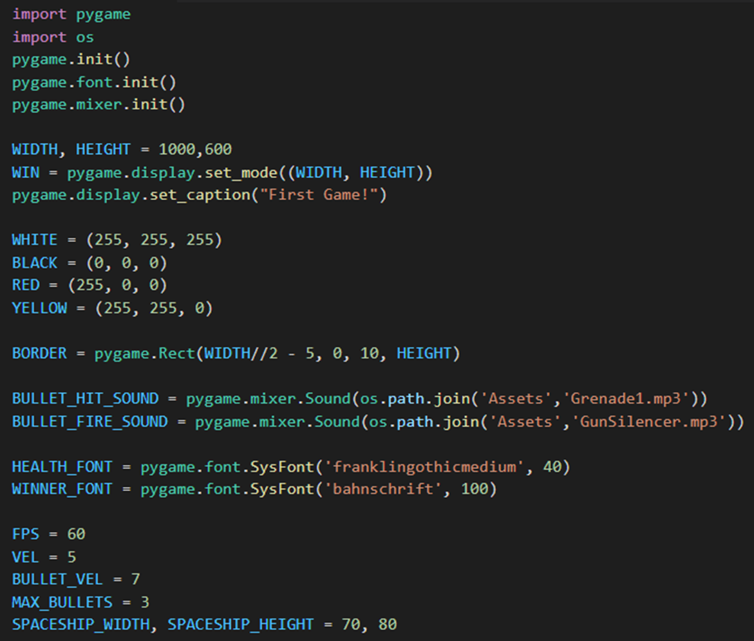
Required modules are imported, game window dimensions are set, mp3 files are imported and global variable are declared

Slide 4
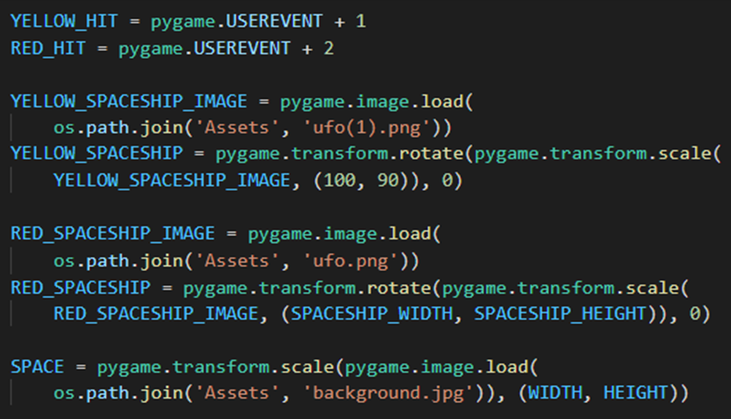
The graphics which are used in the game are imported

Slide 5
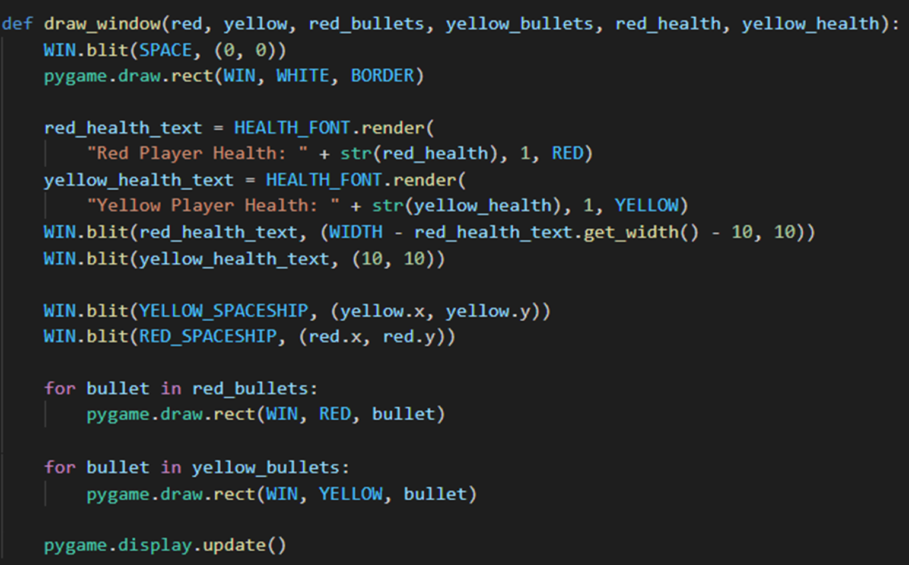
The various components of the game–the space ships, bullets , the health of the players are placed on the game window specifying their size and coordinates

Slide 6
main() function
Calling each and every function one by one to execute the entire program
def main():
red = pygame.Rect(700, 300, SPACESHIP_WIDTH, SPACESHIP_HEIGHT)
yellow = pygame.Rect(100, 300, SPACESHIP_WIDTH, SPACESHIP_HEIGHT)
red_bullets = []
yellow_bullets = []
red_health = 10
yellow_health = 10
clock = pygame.time.Clock()
run = True

Slide 7
while run:
clock.tick(FPS)
for event in pygame.event.get():
if event.type == pygame.QUIT:
run = False
pygame.quit()
exit()
Starting of while loop and
controlling its speed to execute and quitting the game
Now let’s go into the program to see the invader structures, their movements and firing bullets action.

Slide 8
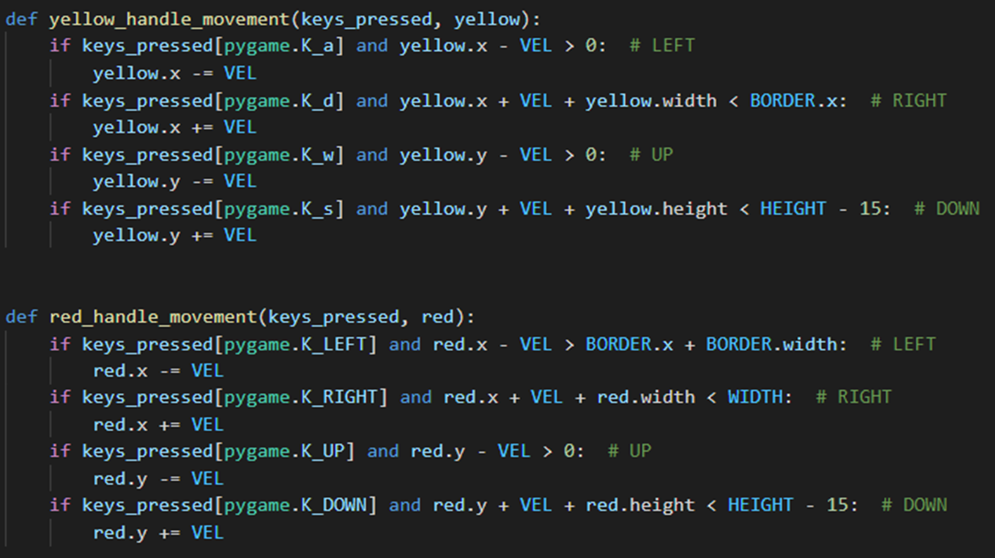
keys_pressed = pygame.key.get_pressed()
yellow_handle_movement(keys_pressed, yellow)
red_handle_movement(keys_pressed, red)
The movement of the yellow spaceship is handled here in this function based upon the the keys that the players enter

Slide 9
Moving our red spaceship in the red_handle_movement functions:
def red_handle_movement(keys_pressed, red):
if keys_pressed[pygame.K_LEFT] and red.x - VEL > BORDER.x + BORDER.width: # LEFT
red.x -= VEL
if keys_pressed[pygame.K_RIGHT] and red.x + VEL + red.width < WIDTH: # RIGHT
red.x += VEL
if keys_pressed[pygame.K_UP] and red.y - VEL > 0: # UP
red.y -= VEL
if keys_pressed[pygame.K_DOWN] and red.y + VEL + red.height < HEIGHT - 15: # DOWN
red.y += VEL

Slide 10
handle_bullets(yellow_bullets, red_bullets, yellow, red)
draw_window(red, yellow, red_bullets, yellow_bullets,
red_health, yellow_health)
main()
Calling the handle_bullets() function from main
From inside the while and subsequent nested for loop,
if event.type == pygame.KEYDOWN:
if event.key == pygame.K_LCTRL and len(yellow_bullets) < MAX_BULLETS:
bullet = pygame.Rect(
yellow.x + yellow.width, yellow.y + yellow.height//2 - 2, 10, 5)
yellow_bullets.append(bullet)
BULLET_FIRE_SOUND.play()

Slide 11
Continuation..
Rounds to move towards the end
if event.key == pygame.K_RCTRL and len(red_bullets) < MAX_BULLETS:
bullet = pygame.Rect(
red.x, red.y + red.height//2 - 2, 10, 5)
red_bullets.append(bullet)
BULLET_FIRE_SOUND.play()
if event.type == RED_HIT:
red_health -= 1
BULLET_HIT_SOUND.play()
if event.type == YELLOW_HIT:
yellow_health -= 1
BULLET_HIT_SOUND.play()

Slide 12
Bullets in the handle_bullets() function:
def handle_bullets(yellow_bullets, red_bullets, yellow, red):
for bullet in yellow_bullets:
bullet.x += BULLET_VEL
if red.colliderect(bullet):
pygame.event.post(pygame.event.Event(RED_HIT))
yellow_bullets.remove(bullet)
elif bullet.x > WIDTH:
yellow_bullets.remove(bullet)
for bullet in red_bullets:
bullet.x -= BULLET_VEL
if yellow.colliderect(bullet):
pygame.event.post(pygame.event.Event(YELLOW_HIT))
red_bullets.remove(bullet)
elif bullet.x < 0:
red_bullets.remove(bullet)

Slide 13
Winning step..
Checking for final result who wins
either yellow or red
winner_text = ""
if red_health <= 0:
winner_text = "Yellow Wins!"
if yellow_health <= 0:
winner_text = "Red Wins!"
if winner_text != "":
draw_winner(winner_text)
break

Slide 14
Declaring winners in the winner_draw() function
def draw_winner(text):
if text =="Yellow Player Wins!":
draw_text = WINNER_FONT.render(text, 1, YELLOW)
WIN.blit(draw_text, (WIDTH/2 - draw_text.get_width() /
2, HEIGHT/2 - draw_text.get_height()/2))
pygame.display.update()
pygame.time.delay(5000)
elif text =="Red Player Wins!":
draw_text = WINNER_FONT.render(text, 1, RED)
WIN.blit(draw_text, (WIDTH/2 - draw_text.get_width() /
2, HEIGHT/2 - draw_text.get_height()/2))
pygame.display.update()
pygame.time.delay(5000)

Slide 15
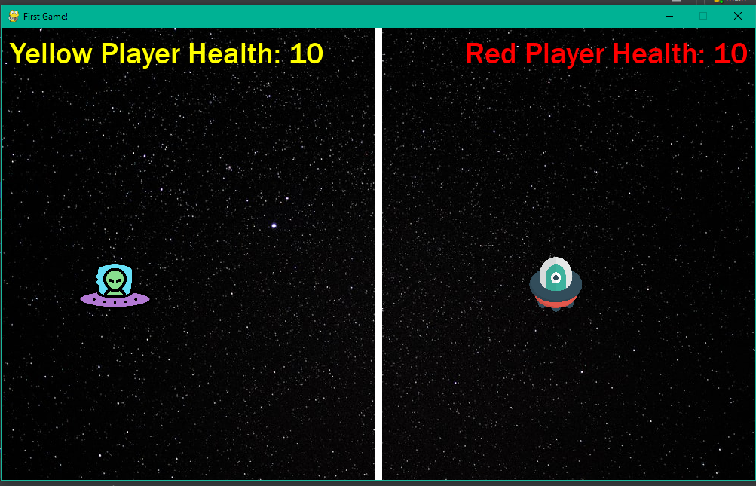
Executing the code and the output
This is the pygame window called “First Game” that greets us when we first execute the game.

Slide 16
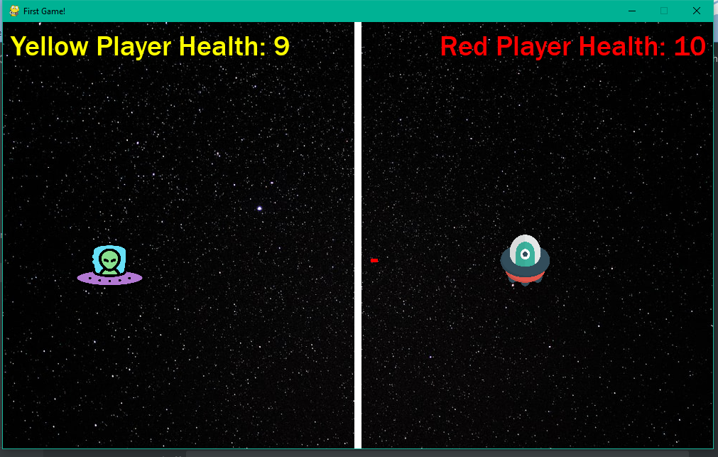
Firing a bullet in the game window:

Slide 17
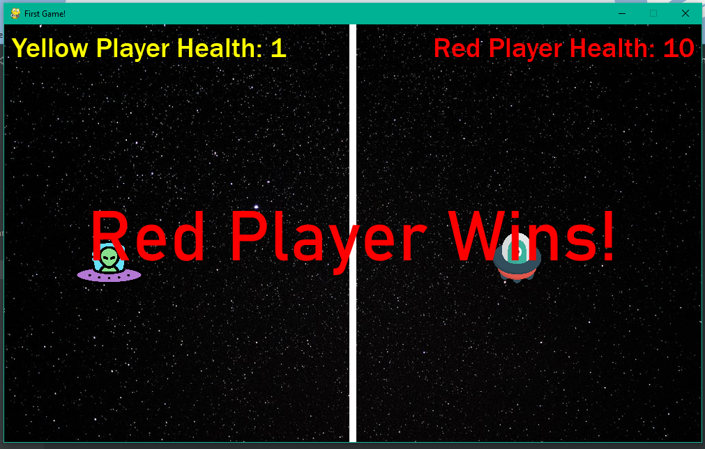
Winning message:

